Slide 1


SUPERVISED BY MRS.C.SELVARATHI,Assistant Professor
PRESENTED BY
1. R.Charan Nag(25636)(23UECS1202)
2. H.SATYA SAI (25470)(23UECS0738)
3. D.VIJAY ( 25436)(23UECS1048)

Slide 2
SMART HOME ANOMALY DETECTION USING IOT & MACHINE LEARNING
AGENDA
Introduction
Literature Survey
Problem Statement
Proposed Methodology
Proposed System Architecture
Implementation Details
Testing & Validation
Preliminary Results & Analysis
Conclusion and Future Work
References

Slide 3
Introduction
Problem Statement:
Smart home systems are becoming increasingly popular in modern living environments. However, these systems often lack the ability to detect abnormal situations such as gas leaks, fire hazards, or unauthorized access in real-time.
Project Goal:
To develop a smart home anomaly detection system that:
Monitors home environment continuously
Detects abnormal conditions.
Sends real-time alerts to users
Brief Overview:
A system using sensors + IoT + Machine Learning monitors home conditions and provides alerts through mobile or dashboard.

Slide 4
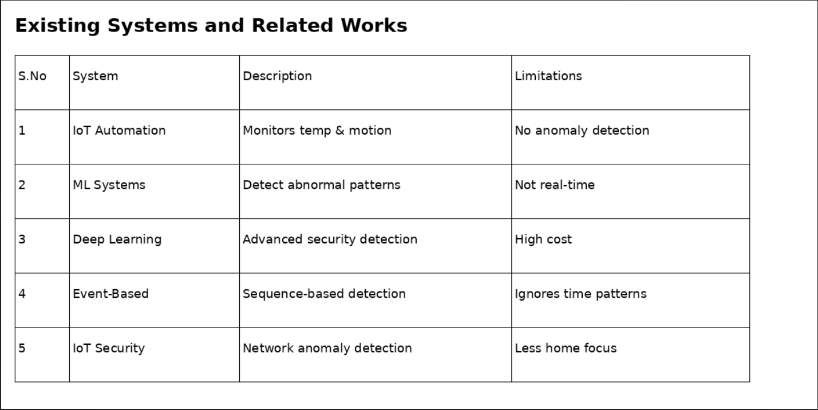
Literature Survey

Slide 5
Problem Statement
Limitations of Existing Solutions
No real-time anomaly detection
Cannot understand human behavior
No predictive analysis
No voice assistant support
Lack of safety alert mechanisms
No training support for new workers

Slide 6
Proposed Methodology
Requirement Analysis: Study home environment conditions and identify possible risks like gas leakage, fire, and intrusion.
System Design: Create architecture including Data Collection Module, ML Engine, and Alert System.
Data Collection: Collect real-time sensor data from temperature, gas, and motion sensors.
Model Development: Train Machine Learning models for anomaly detection and prediction.
Real-Time Monitoring: System continuously monitors data and detects abnormal patterns
Alert System: Provide real-time notifications and warnings to users.
Testing & Deployment: Evaluate system performance and deploy in real-time environment.

Slide 7
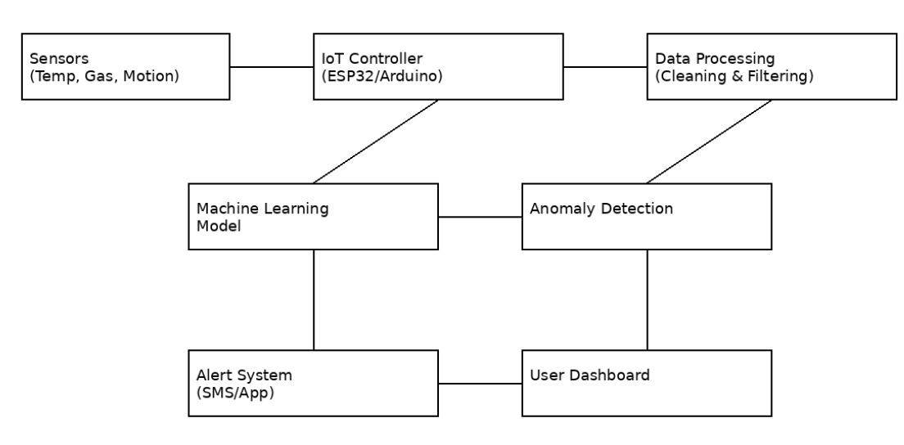
Proposed System Architecture

Slide 8
Summary of Module -1
Data Acquisition Module: This module is responsible for collecting real-time data using sensors such as temperature, gas, and motion sensors. These sensors are connected to an IoT device like ESP32 or Arduino, which continuously gathers environmental data from the home. The collected data is transmitted to the server or cloud for processing.
This module focuses on identifying real-time conditions inside the home and detecting potential risks such as fire, gas leakage, or unauthorized entry.

Slide 9
Summary of Module -2
Data Processing & Storage Module: In this module, raw sensor data is cleaned, filtered, and preprocessed to remove noise and missing values. Important features are extracted for analysis. The processed data is then stored securely in a database or cloud platform.
This module prepares structured data for Machine Learning analysis and ensures reliable data handling.

Slide 10
Summary of Modules -3
AI & Anomaly Detection Module: This module applies Machine Learning algorithms to analyze patterns in the collected data. It detects abnormal behavior such as sudden temperature rise, gas leakage, or unusual motion.
The AI model continuously monitors data and predicts potential risks based on learned patterns. It generates alerts when abnormal conditions are detected.

Slide 11
Summary of Modules -4
Alert & Visualization Module: This module provides real-time alerts and notifications to users through mobile applications or dashboards. It displays system status such as Normal, Warning, or Critical conditions along with graphical reports and logs.
This module helps users take immediate action and ensures safety and efficient monitoring of the smart home.

Slide 12
Implementation Details
Data Acquisition: Sensors + IoT device (ESP32 / Arduino)
Data Preprocessing: Python (NumPy, Pandas) Cleaning and normalization
Machine Learning Model: Algorithms: Random Forest / Isolation Forest / Neural Networks Training using collected data Evaluation using accuracy

Slide 13
Testing & Validation
Testing Methodology:
Real-time sensor testing
Simulation testing
Test Cases:
Normal condition
Gas leakage
High temperature/fire
Unauthorized motion
Validation Metrics:
Accuracy
Detection rate
Response time

Slide 14
Preliminary Results & Analysis
The Smart Home Anomaly Detection system was tested using real-time sensor data. The system successfully monitored environmental parameters such as temperature, gas levels, and motion activity.
The Machine Learning model identified abnormal conditions with an accuracy of approximately 90%.
Analysis:
Early detection of dangerous situations
Improved home safety
Faster response compared to manual monitoring
Continuous real-time monitoring system

Slide 15
Software & Hardware Requirements Specification
Hardware Requirements:
ESP32 / Arduino
Temperature Sensor
Gas Sensor
Motion Sensor
Power Supply
Wi-Fi Module
Software Requirements:
Arduino IDE / VS Code
Python Programming
Machine Learning Libraries (NumPy, Pandas, Scikit-learn, TensorFlow)

Slide 16
Conclusion and Future Work
Conclusion:
Successfully developed Smart Home Anomaly Detection system
Provides real-time monitoring and alert system
Improves safety and reduces risks
Works efficiently using IoT and Machine Learning
Future Work:
Integrate mobile application
Use advanced deep learning models
Add voice assistant support
Expand to smart city systems

Slide 17
References
Research Paper – “Predictive Maintenance using Machine Learning in Industrial IoT” – IEEE Xplore Digital Library.
Research Paper – “Anomaly Detection in Industrial Machines using IoT and AI Techniques” – Springer Journal of Industrial Engineering.YouTube – “ESP32 IoT Tutorial for Beginners”https://youtu.be/WqgRCDiuehU
YouTube – “Machine Learning for Predictive Maintenance” https://youtu.be/1gGxR0yZ6qk
ThingSpeak Official Documentation – IoT Data Monitoring Platformps https://thingspeak.com/docs
TensorFlow Official Documentation – Machine Learning Library https://www.tensorflow.org/
Arduino Official Documentation
https://www.arduino.cc/reference/en/

Slide 18
THANK YOU

